Slide 1

WEB SECURITY CONSIDERATIONS

Slide 2
Web Security Considerations
Web security refers to the security of data on the Internet/network or the web or during data transmission over the Internet.
For example., When you transfer data between client and server and you need to protect that data, data security is your web security.
The World Wide Web is fundamentally a client/server application running over the Internet and TCP/IP intranets.
Client Server Architecture :
The Client-server model is a distributed application structure that partitions task or workload between the providers of a resource or service, called servers, and service requesters called clients.
In the client-server architecture, when the client computer sends a request for data to the server through the internet, the server accepts the requested process and deliver the data packets requested back to the client

Slide 3
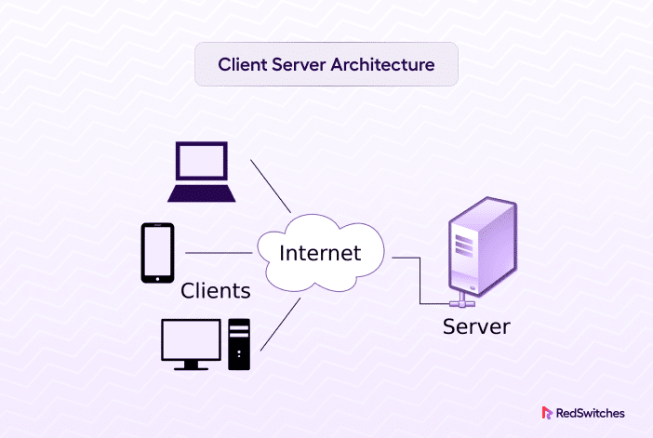

Slide 4
The following characteristics of Web usage suggest the need for tailored security tools:
Despite the user-friendly nature of web browsers and the straightforward setup of web servers, the underlying software is complex and prone to security flaws, leading to vulnerabilities.
A compromised web server can serve as a gateway to infiltrate an organization's entire computer network. By exploiting vulnerabilities in the server, attackers can potentially access data and systems beyond the web environment, extending to other connected resources within the local network.
Casual and untrained (in security matters) users are common clients for Web?based services. Such users are not necessarily aware of the security risks that exist and do not have the tools or knowledge to take effective countermeasures

Slide 5
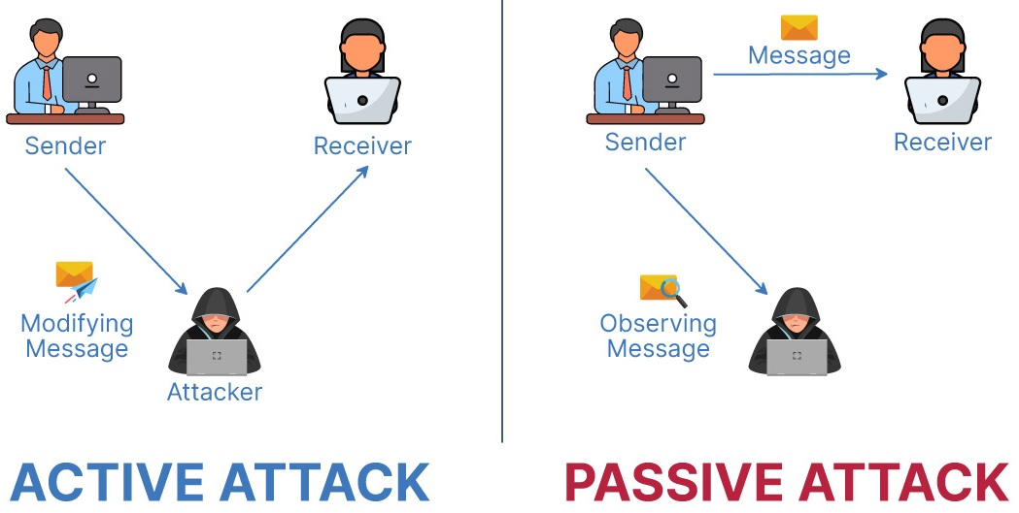
Web Security Threats
Types of attacks:
Active attacks
Passive attacks

Slide 6
Web security threats classified based on the location of threat:
Web server, Web browser, and network traffic between browser and server.
The interconnected components of web technology include the web server, which hosts websites, the web browser used by users to access these sites, and the network traffic that facilitates communication between the browser and server, enabling the retrieval and display of web content.

Slide 7
Some of the most common web security threats are as follows
Cross-site scripting (XSS): Exploits vulnerabilities in web applications to inject malicious scripts into web pages viewed by users.
SQL Injection: Manipulates SQL queries to gain unauthorized access to databases, potentially compromising sensitive information.
Phishing: Deceives users into disclosing personal or sensitive information by posing as legitimate entities via email, text messages, or fraudulent websites.

Slide 8
Code Injection: Insertion of malicious code into a software application to compromise its integrity or exploit vulnerabilities.
Viruses and Worms: Malicious software that spreads and infects other files or systems, potentially causing damage or stealing information.
Spyware: Secretly gathers user information without their consent, often for malicious purposes such as identity theft or espionage.

Slide 9
Ransomware: Malicious software that encrypts files or systems, demanding ransom payments for decryption, often causing significant disruption or data loss.
Denial of Service (DoS): Overloads a system or network with excessive requests, rendering it inaccessible to legitimate users, while Distributed Denial of Service (DDoS) attacks involve multiple sources coordinating to disrupt services.

Slide 10
Web Traffic Security Approaches
A number of approaches to providing Web security are possible. The various approaches that have been considered are similar in the services they provide and, to some extent, in the mechanisms that they use, but they differ with respect to their scope of applicability and their relative location within the TCP/IP protocol stack

Slide 11
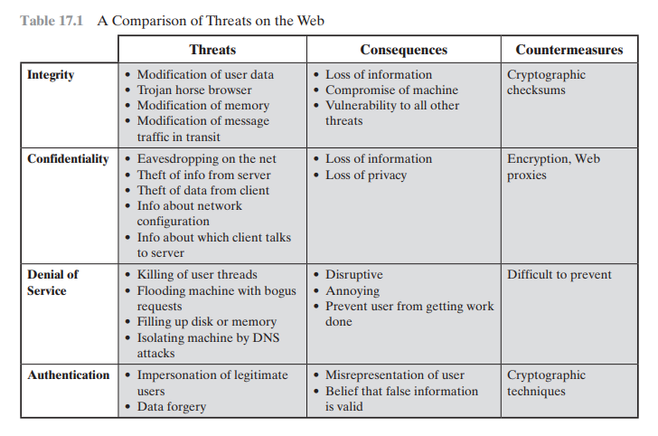

Slide 12
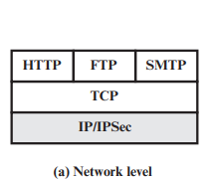
One way to provide Web security is to use IP security (IPsec) .
The advantage of using IPsec is that it is transparent to end users and applications and provides a general-purpose solution, filtering capability.

Slide 13
Transparency: It operates at the network layer, ensuring that end users and applications are unaware of its presence, thus maintaining seamless communication without requiring any additional configuration or changes.
General-purpose solution: IPsec provides a comprehensive security framework that can be applied across various network configurations and applications, offering flexibility and scalability in securing communication channels.
Filtering capability: IPsec includes filtering mechanisms that allow administrators to selectively apply security measures to specific traffic, reducing overhead by focusing encryption and authentication processes only on the necessary data flows. This ensures efficient utilization of resources while maintaining security for critical communication.

Slide 14
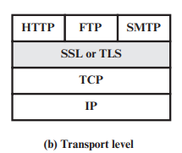
Another relatively general-purpose solution is to implement security just above TCP.
At this level, there are two implementation choices. For full generality, SSL (or TLS) could be provided as part of the underlying protocol suite and therefore be transparent to applications.
Alternatively, TLS can be embedded in specific packages. For example, virtually all browsers come equipped with TLS, and most Web servers have implemented the protocol

Slide 15
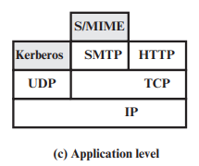
Application-specific security services are embedded within the particular application. The advantage of this approach is that the service can be tailored to the specific needs of a given application

Slide 16
THANK YOU
Mahanthi Darshana Naidu
21131A05A7

